Slide 1



Project Q5 Further development of TURBOMOLE´s NMR module – improved efficiency and enhanced functionality
Workshop Annweiler/Trifels 29.03. - 31.03.2017
Kevin Reiter

Slide 2

Q5-B Further development of TURBOMOLE´s NMR module: status 03/2016
PB1: heavy elements (Z>36): relativistic core potentials
PB1a: Vibrational Circular Dichroism (VCD) spectra
PB2: environmental / solvent effects: COSMO-Model
PB3: efficiency: RI-J approximation
PB4: all electron relativistic (outlook at the 2nd period)

Slide 3
Q5-B Further development of TURBOMOLE´s NMR module: status 03/2017
PB1: heavy elements (Z>36): relativistic core potentials
PB1a: Vibrational Circular Dichroism (VCD) spectra
PB2: environmental / solvent effects: COSMO-Model + point charge model, + Gaussian smeared charge model
PB3: efficiency: RI-J approximation + multipole-accelerated RI-J (MARI-J) approximation
PB4: all electron relativistic (outlook at the 2nd period)

Slide 4
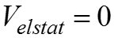
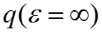
Q5-B: environmental / solvent effects (PB2)
COnductor-like Screening Model (COSMO): - continuum solvation model - solute forms cavity within the dielectric continuum of permittivity ε - solute polarizes the dielectric medium → response is described by generation of screening charges Simulation of environmental / solvent effects by specification of on a shell around the molecule → screening charges finite permittivity of real solvents → scaling by factor

Slide 5
Q5-B: environmental / solvent effects (PB2): application – acetone in water
Snapshots of acetone + water solvent molecules from MD-simulations (fixed structure parameters for acetone)
Different possibilities of solvent treatment
model by point charges
model by Gaussian smeared charges
c) explicit calculation of water molecules
d) or combinations of a/b) and c)

Slide 6
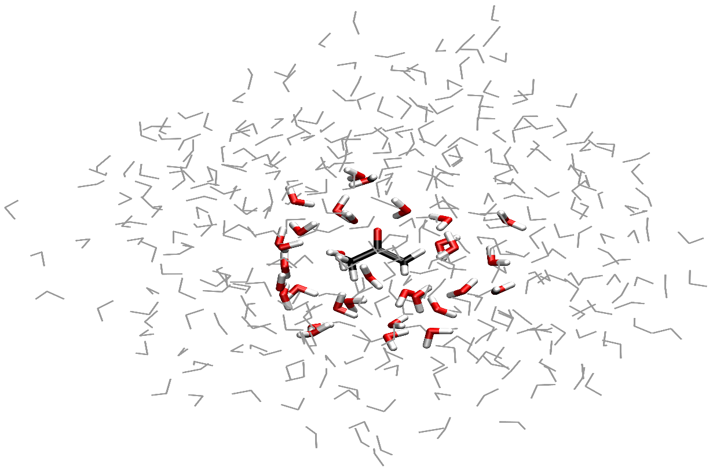
Q5-B: environmental / solvent effects (PB2)
COSMO
Exp.
Exp.
Point charges
Gaussian
smeared charges
16 H
O + PC
2
16 H
O
2
32 H
O
2
64 H
O
2
40
60
80
100
120
140
-25
-20
-15
-10
-5
σ
σ
σ
σ
(
O
)-
(
O
)
/ ppm
(
C
=O)-
(
gas phase
C
=O)
gas phase
/ ppm
σ(O), σ(C) : average over 100 snapshots (414 H₂O)

Slide 7
Q5-B: efficiency (PB3): RI-J approximation
Derivative of two electron integrals
Coulomb part (formal O(N⁴) scaling behavior with the number of basis functions) is symmetric, is antisymmetric → second term vanishes

Slide 8
Q5-B: efficiency (PB3): RI-J approximation
Resolution of the identity approximation: RI-J will be calculated in advance
Final evaluation formal O(N³) scaling behavior with the number of basis functions

Slide 9
Q5-B: efficiency (PB3): MARI-J approximation
Multipole accelerated resolution of the identity approximation: MARI-J Coulomb term is divided in a near-field (NF) and far-field (FF) part
NF part is evaluated by the RI-J approximation
FF part: Coulomb interaction J_{OR} of two continuous charge distributions σ^{O} and σ^{R} can be factorized are the multipole moments centered at O, are the coefficients of a local Taylor-type expansion of the potential → truncation after l=L leads to a fast evaluation of J_{OR}

Slide 10
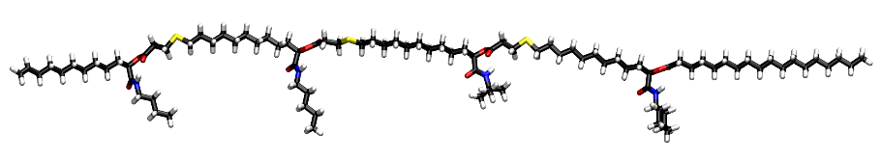
Q5-B: efficiency (PB3): application I
Method: PBE/def2-TZVP
C₉₄H₁₇₄O₁₂N₄S₃ (287 atoms)
Bild von mittelfettem Molekül
CPU time
 | total | speedup | 2e⁻ coulomb part | speedup
Energy | 42min
NMR | 5h43min |  | 5h16min
NMR (RI-J) | 57min | 6.0 | 28min | 11.1
NMR (MARI-J) | 33min | 10.4 | 5min | 57.9

Slide 11
Q5-B: efficiency (PB3): application II
COSMO application for a highly negatively charged DNA sequence
Method: PBE/def2-SV(P)/COSMO
[C₃₀₄H₃₄₆O₂₂₀N₁₁₈P₃₀]³⁰⁻ (1018 atoms)
CPU time
 | total | speedup | 2e⁻ coulomb part | speedup
Energy | 9h 52min
NMR | 43h 11min |  | 36h 9min
NMR (RI-J) | 14h 53 min | 2.9 | 7h 39min | 4.7
NMR (MARI-J) | 7h 49min | 5.5 | 36 min | 61.0

Slide 12
Q5-B Further development of TURBOMOLE´s NMR module: outlook
PB3: efficiency: RI-J + MARI-J approximation
+ linear-scaling DFT routines (+meta-GGA-functionals)
+ parallelization
PB4: all electron relativistic (outlook at the 2nd period)
NMR-related cooperation?!

